Slide 1
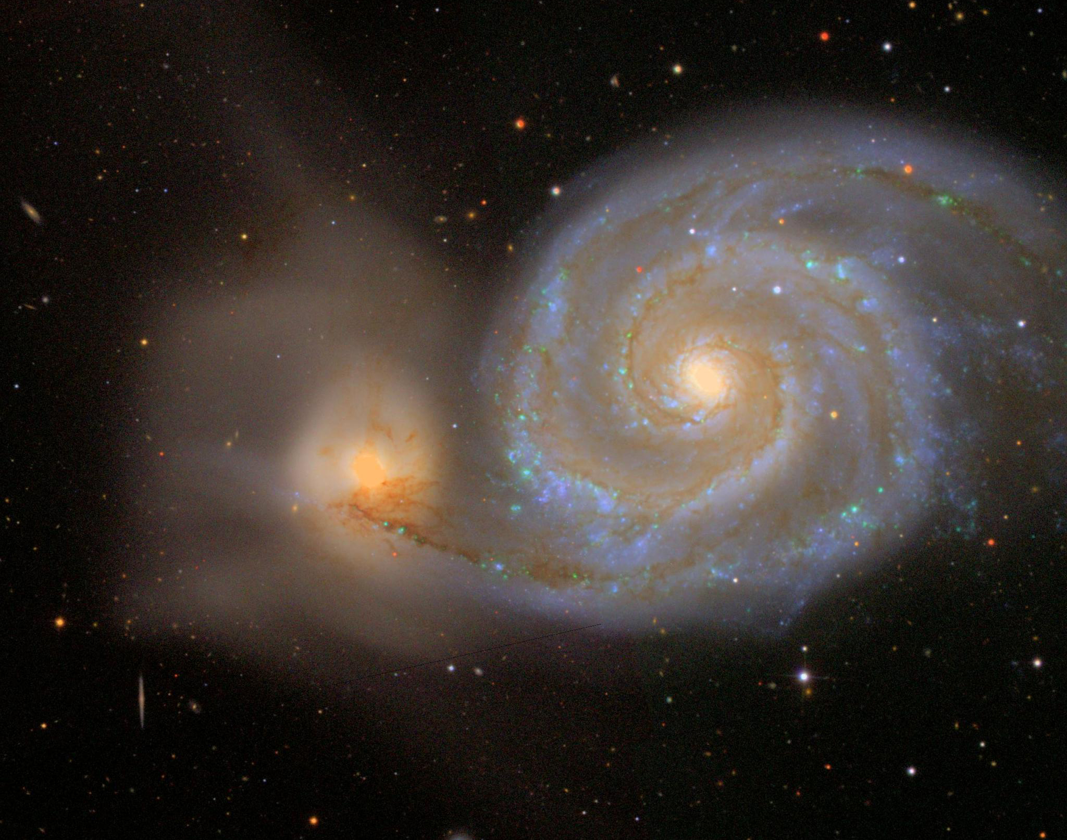
Galaxy Exploration with SDSS
MIT WSP 2024
Led by Laurel White
Image credit: SDSS

Slide 2
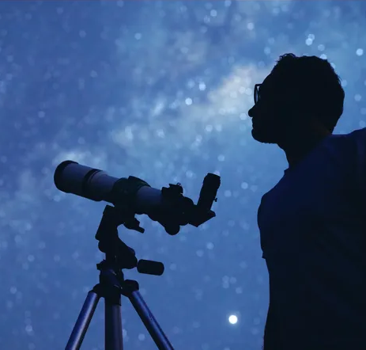
This week, you will…
Work with real telescope data from the Sloan Digital Sky Survey
Use Python to analyze data
Weigh a galaxy cluster
Image credit: Getty

Slide 3
Schedule
Monday
Wednesday
SDSS and optical telescopes
Intro to coding in Python
Finish gathering data
Weighing galaxy clusters
Tuesday
Thursday
Properties of galaxies
Start gathering data
Analyze data
Compare estimated mass of galaxy cluster to expectations
Friday
Wrap up
Work on presentation

Slide 4
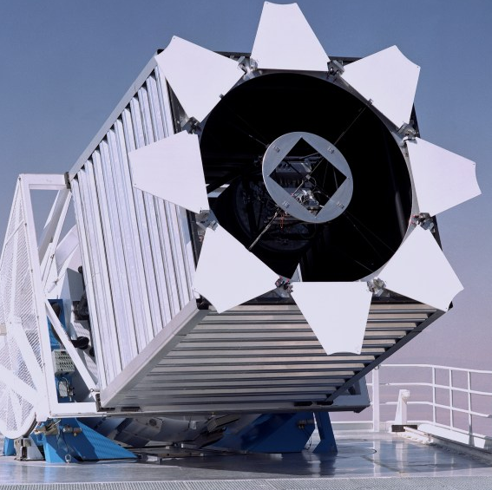
Optical telescopes
Capture visible light emitted by objects in the sky
Can be space-based or ground-based
Difficult to get both deep and wide observations
Image credit: SDSS

Slide 5
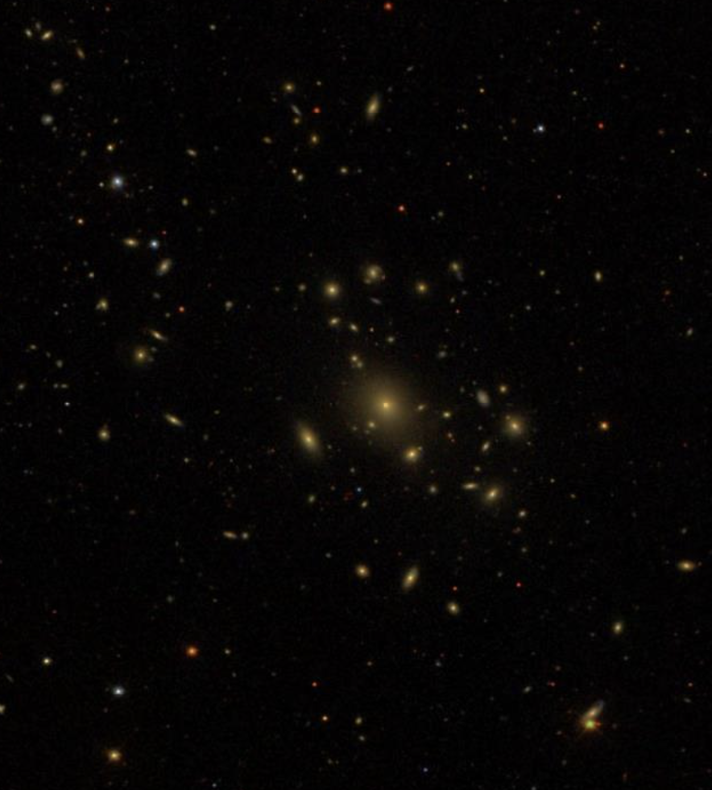
Sloan digital sky survey
Apache Point Observatory in New Mexico
Covers 25% of the sky
Imaging and spectroscopy
Image credit: SDSS

Slide 6
Intro to coding in Python
Working with lots of data is easier with Python
We will work through a basic tutorial using a Jupyter Notebook on Google Colab

Slide 7
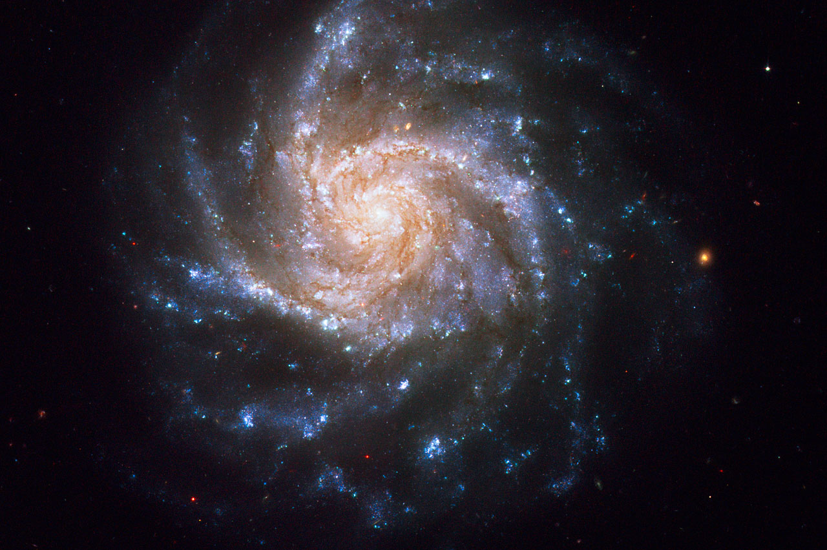
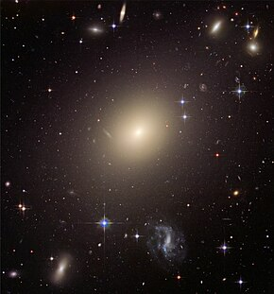
Galaxies: Visual properties
Different shapes, sizes, and colors!
Younger galaxies tend to be:
Blue
Spiral
Star-forming
Dusty
Older galaxies tend to be:
Red
Elliptical
Quiescent
Image credit: Hubble

Slide 8
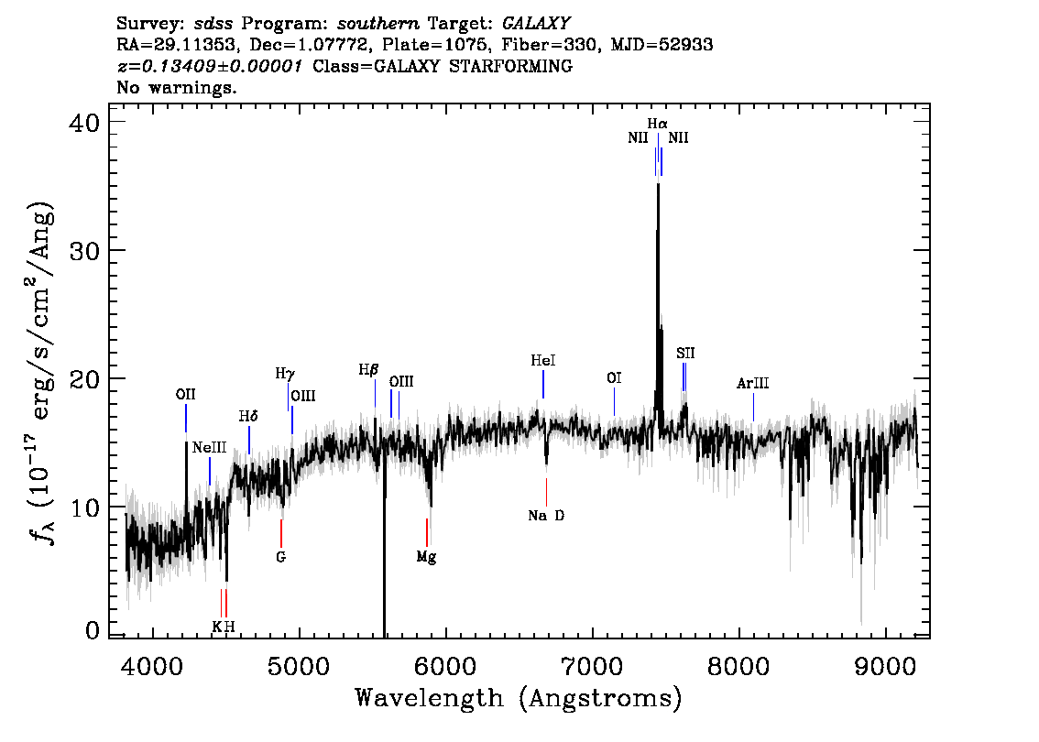
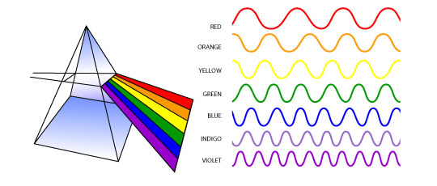
Galaxies: Spectroscopy
Measure amount of light emitted at different wavelengths
Check out our SDSS plate: https://voyages.sdss.org/for-educators/sdss-plates-for-education/my-plate/discovering-constellations-using-sdss-plates/
Image credit: chem.fsu.edu, SDSS

Slide 9
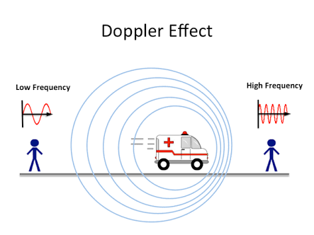
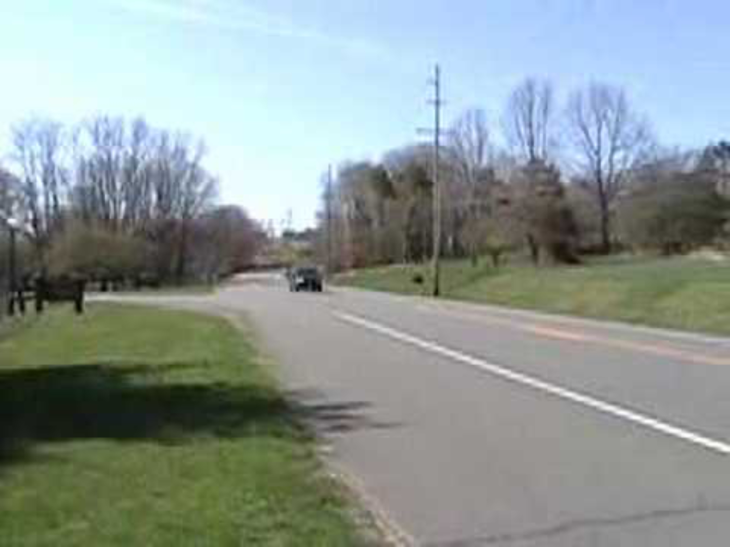
Redshift
Motion of objects changes frequency of emitted light
Cosmological redshift due to expansion of universe: z=H₀d
Doppler shift due to motion of object: z=v/c
Image credit: Tuttee Academy

Slide 10
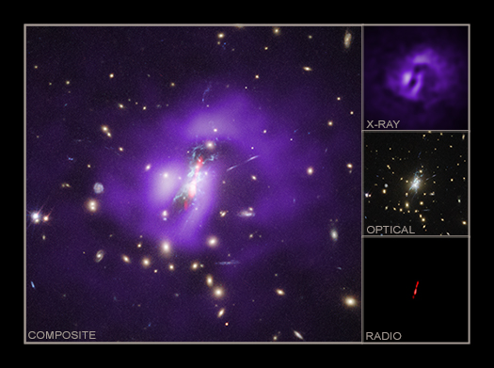
Galaxy clusters
Galaxies are bound together by gravity in clusters of hundreds to thousands
Different components are observable in different wavelengths
Mass of cluster dictates speeds of galaxies
Image credit: CXO

Slide 11
Project goal
Use SDSS to find galaxies in the Coma Cluster
Record their redshifts
Convert the redshifts to a velocity dispersion
Use the virial theorem to get a mass estimate of the Coma Cluster

Slide 12
SDSS Skyserver
Website: https://skyserver.sdss.org/dr17
Navigate tool lets you explore the sky!
Find objects (like the Coma Cluster) by name
Click on individual objects to see information about them
Galaxies will have spectra that show the redshifts
Locate at least 50 galaxies in the cluster and record their names and redshifts in a spreadsheet
Coma Cluster has a radius of ~1300 kpc or ~46.5 arcmin
RA: 193.9-195.6, Dec: 27.2-28.7
Scale: 6.3380272 ’’/px

Slide 13
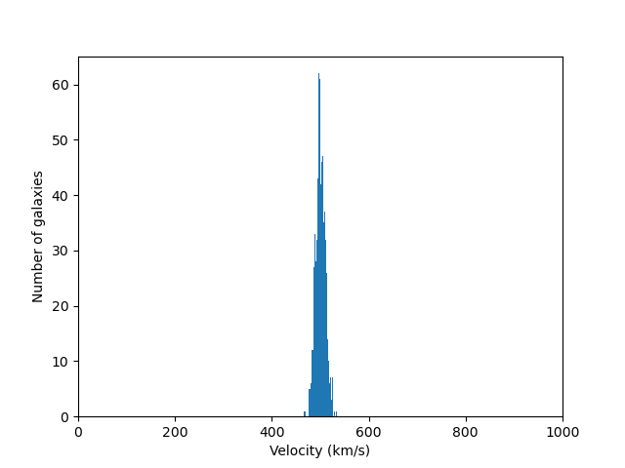
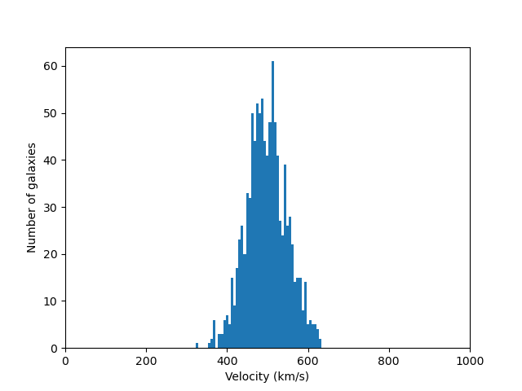
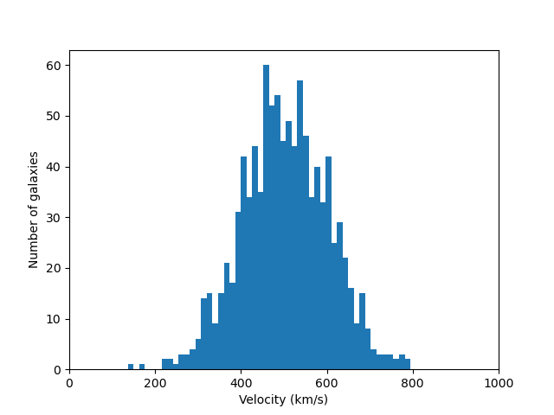
Velocity dispersion
Describes the spread in velocity values
Should be ~100s-1000s km/s for galaxies in a cluster
Dispersion of 10 km/s
Dispersion of 50 km/s
Dispersion of 100 km/s
Image credit: SDSS

Slide 14
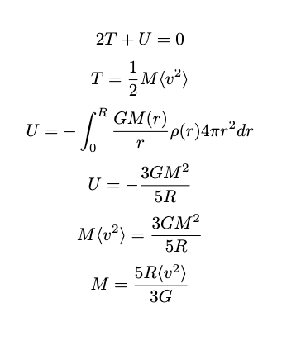
Virial Theorem
Image credit: CXO

Slide 15
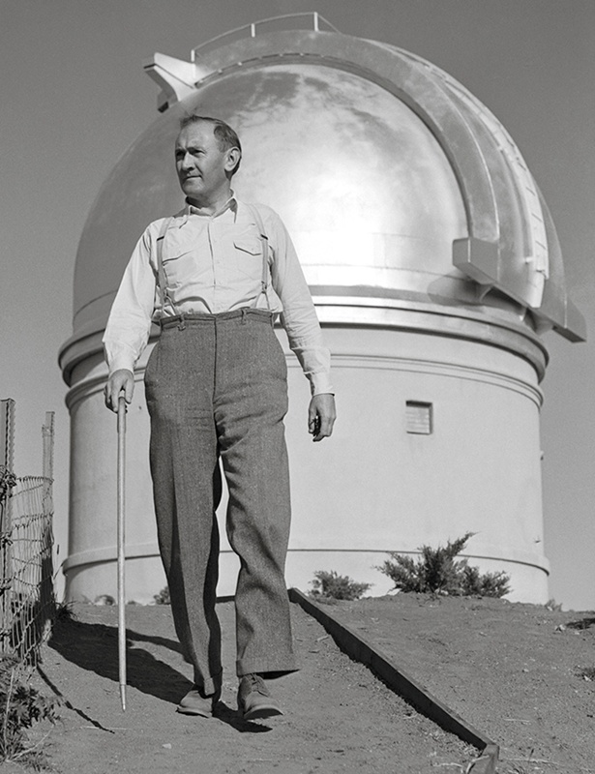
Fritz Zwicky
Image credit: https://www.nmspacemuseum.org/inductee/fritz-zwicky/

Slide 16
Dunkle materie
On the Masses of Nebulae and the Clusters of Nebulae
Published by Zwicky in 1937

